Slide 1


Slide 2
Engineering Excellence – J1
Hadoop Cluster Setup
01 Review meeting : 05/27/2016
SPRINT 1 (May 23– May 27)

Slide 3
Last Week’s Action Items
Sanchita has to send weekly review sheet on Friday before review meeting. -Done
Team should prepare the demo PPT for the weekly Sprint deliverables. -Done
Sprint planning should be done before Monday - Done
Machines will be available for case study by next week Monday or Tuesday. - Done

Slide 4
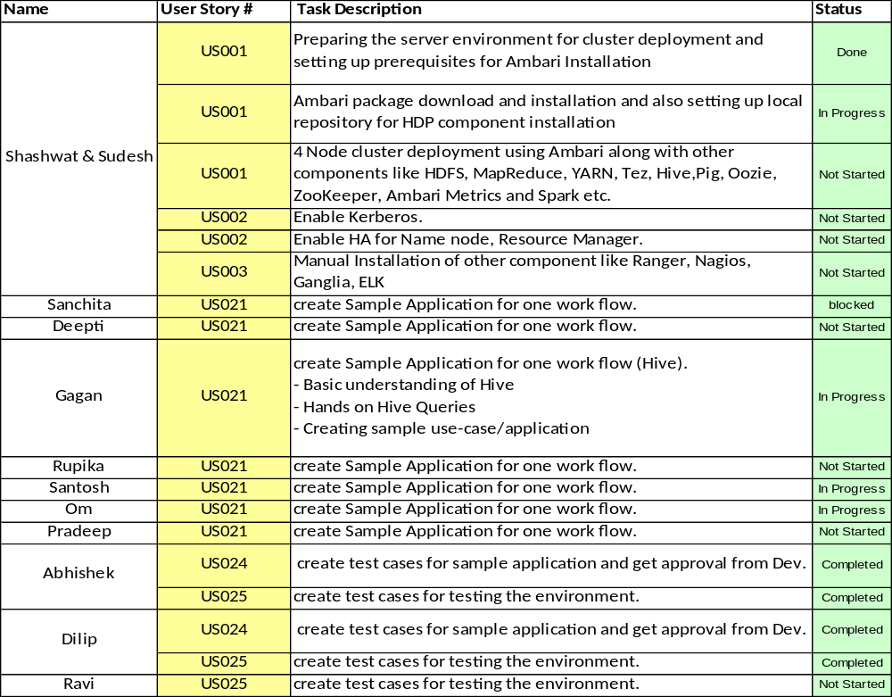
Team Status (Sprint 1)

Slide 5
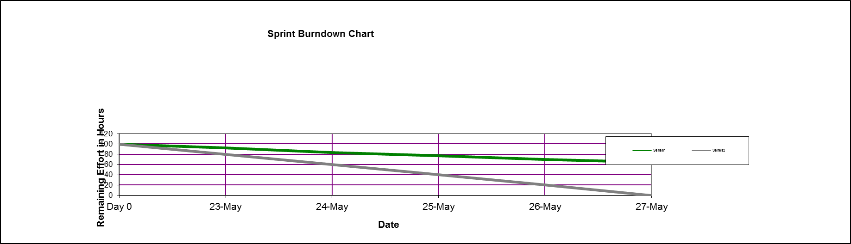
Burn down chart on – 05/27/2016

Slide 6
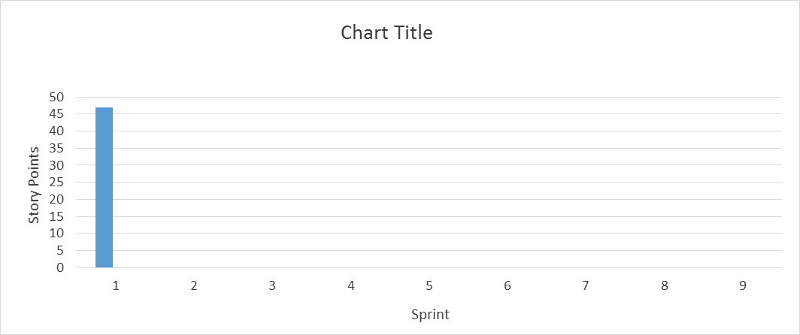
Velocity Trend on– 05/27/2016

Slide 7
Thanks

